Slide 1
I want to traverse this graph… How? Dylan Blecher, COMP2521
I want to start from node 0 and then see all nodes from there.
In trees, we could go left or right. What now?
From the start node, go to all neighbours, from smallest to largest. Repeat from neighbours.

Slide 2
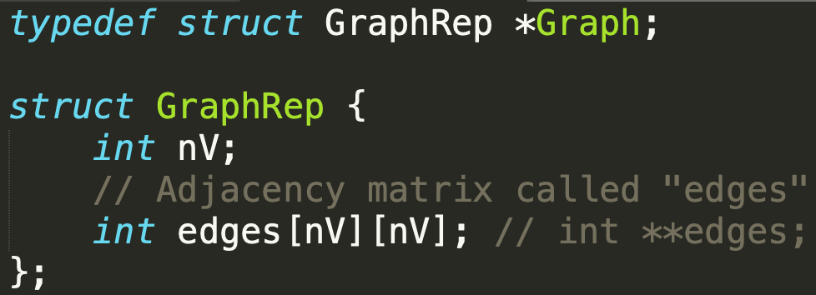
Example Graph Structure

Slide 3
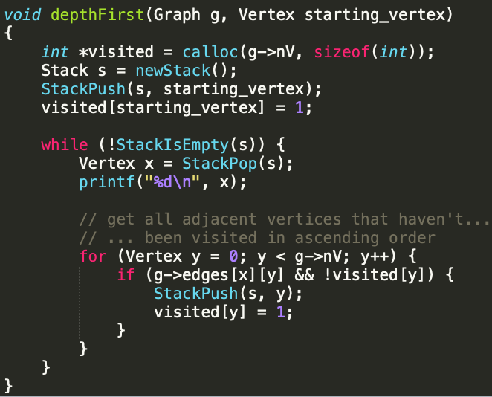
Depth First Search (DFS)
v = 0 (start)
visited:
Stack s:
Visiting order:
Index | 0 | 1 | 2 | 3 | 4 | 5 | 6 | 7
Seen (0 or 1) | 0 | 0 | 0 | 0 | 0 | 0 | 0 | 0
g

Slide 4
Depth First Search (DFS)
Go from node 0 → 3
0
1 2 5 6 7
4
3
g

Slide 5
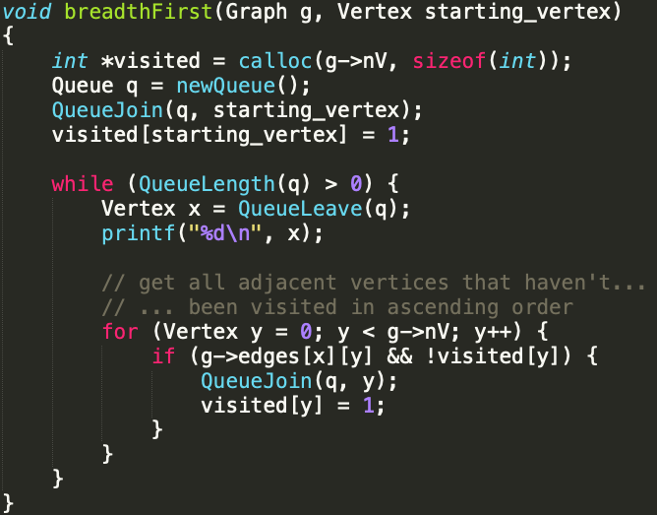
Breadth First Search (BFS)
v = 0 (start)
visited:
Queue q:
Visiting order:
Index | 0 | 1 | 2 | 3 | 4 | 5 | 6 | 7
Seen (0 or 1) | 0 | 0 | 0 | 0 | 0 | 0 | 0 | 0
g

Slide 6
Breadth First Search (BFS)
Go from node 0 → 3
0
1 2 5 6 7
3 4
g

